Slide 1
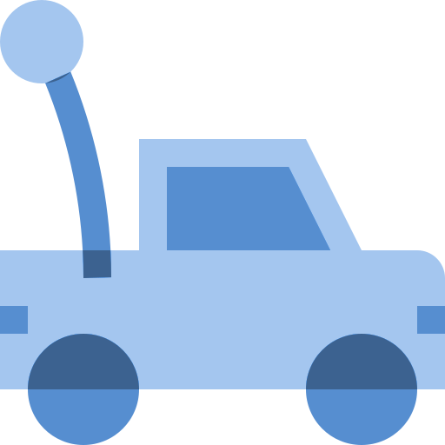
MYOMOBILE
By: Navya, Denise, Lucy, James, and Brice

Slide 2
TABLE OF CONTENTS
01
OUR STORY
03
SOCIAL IMPACT AND ETHICS
02
04
TECHNOLOGY USED
DEMONSTRATION
Where our genius was born
Different considerations
All the equipment we used
Behold our magnificent creation!

Slide 3


01
OUR STORY

Slide 4

REHABILITATION FOR CHILDREN
Common reasons physical therapy is needed:
Neuromuscular conditions
Sports injuries
Stroke/brain injury
Young children may not understand why they need physical therapy, so why not make it more fun for them!

Slide 5

02
TECH USED

Slide 6

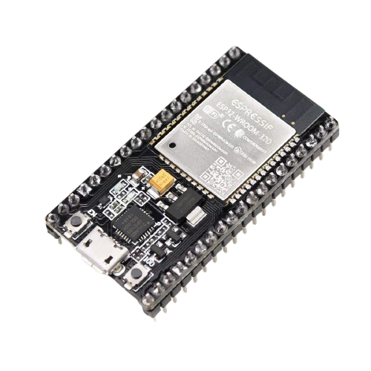
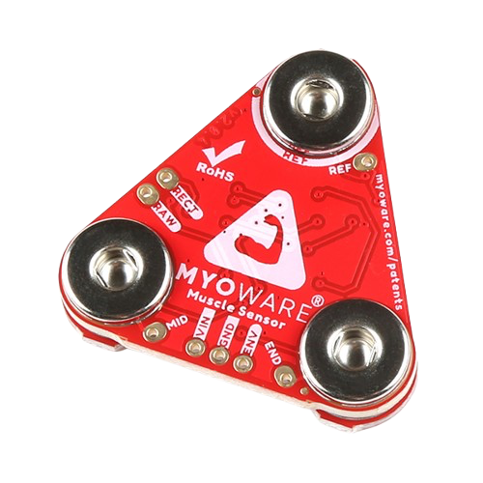

USE OF EXISTING TECHNOLOGY
Novel Use of Existing Technology: EMG sensors and microcontrollers
Scientific Proficiency and Feasibility: The use of EMG sensors combined with the ESP32 microcontroller is a proven approach to signal processing, allowing for real-time interpretation of muscle signals

Slide 7
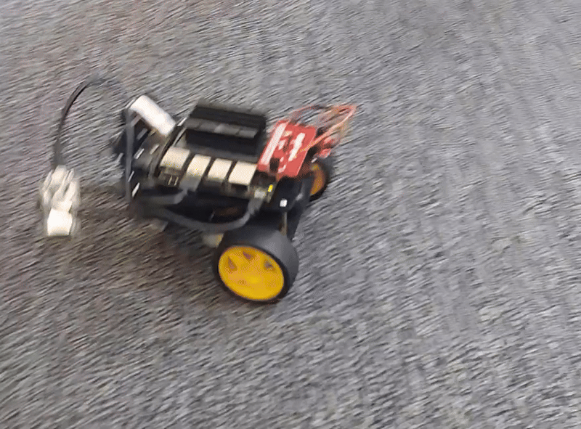
03
INTRODUCING THE MYOMOBILE
MYLO!
“Myo" is derived from muscle ("myo" in Greek), and "Mobile" reflects the robotic car.

Slide 8
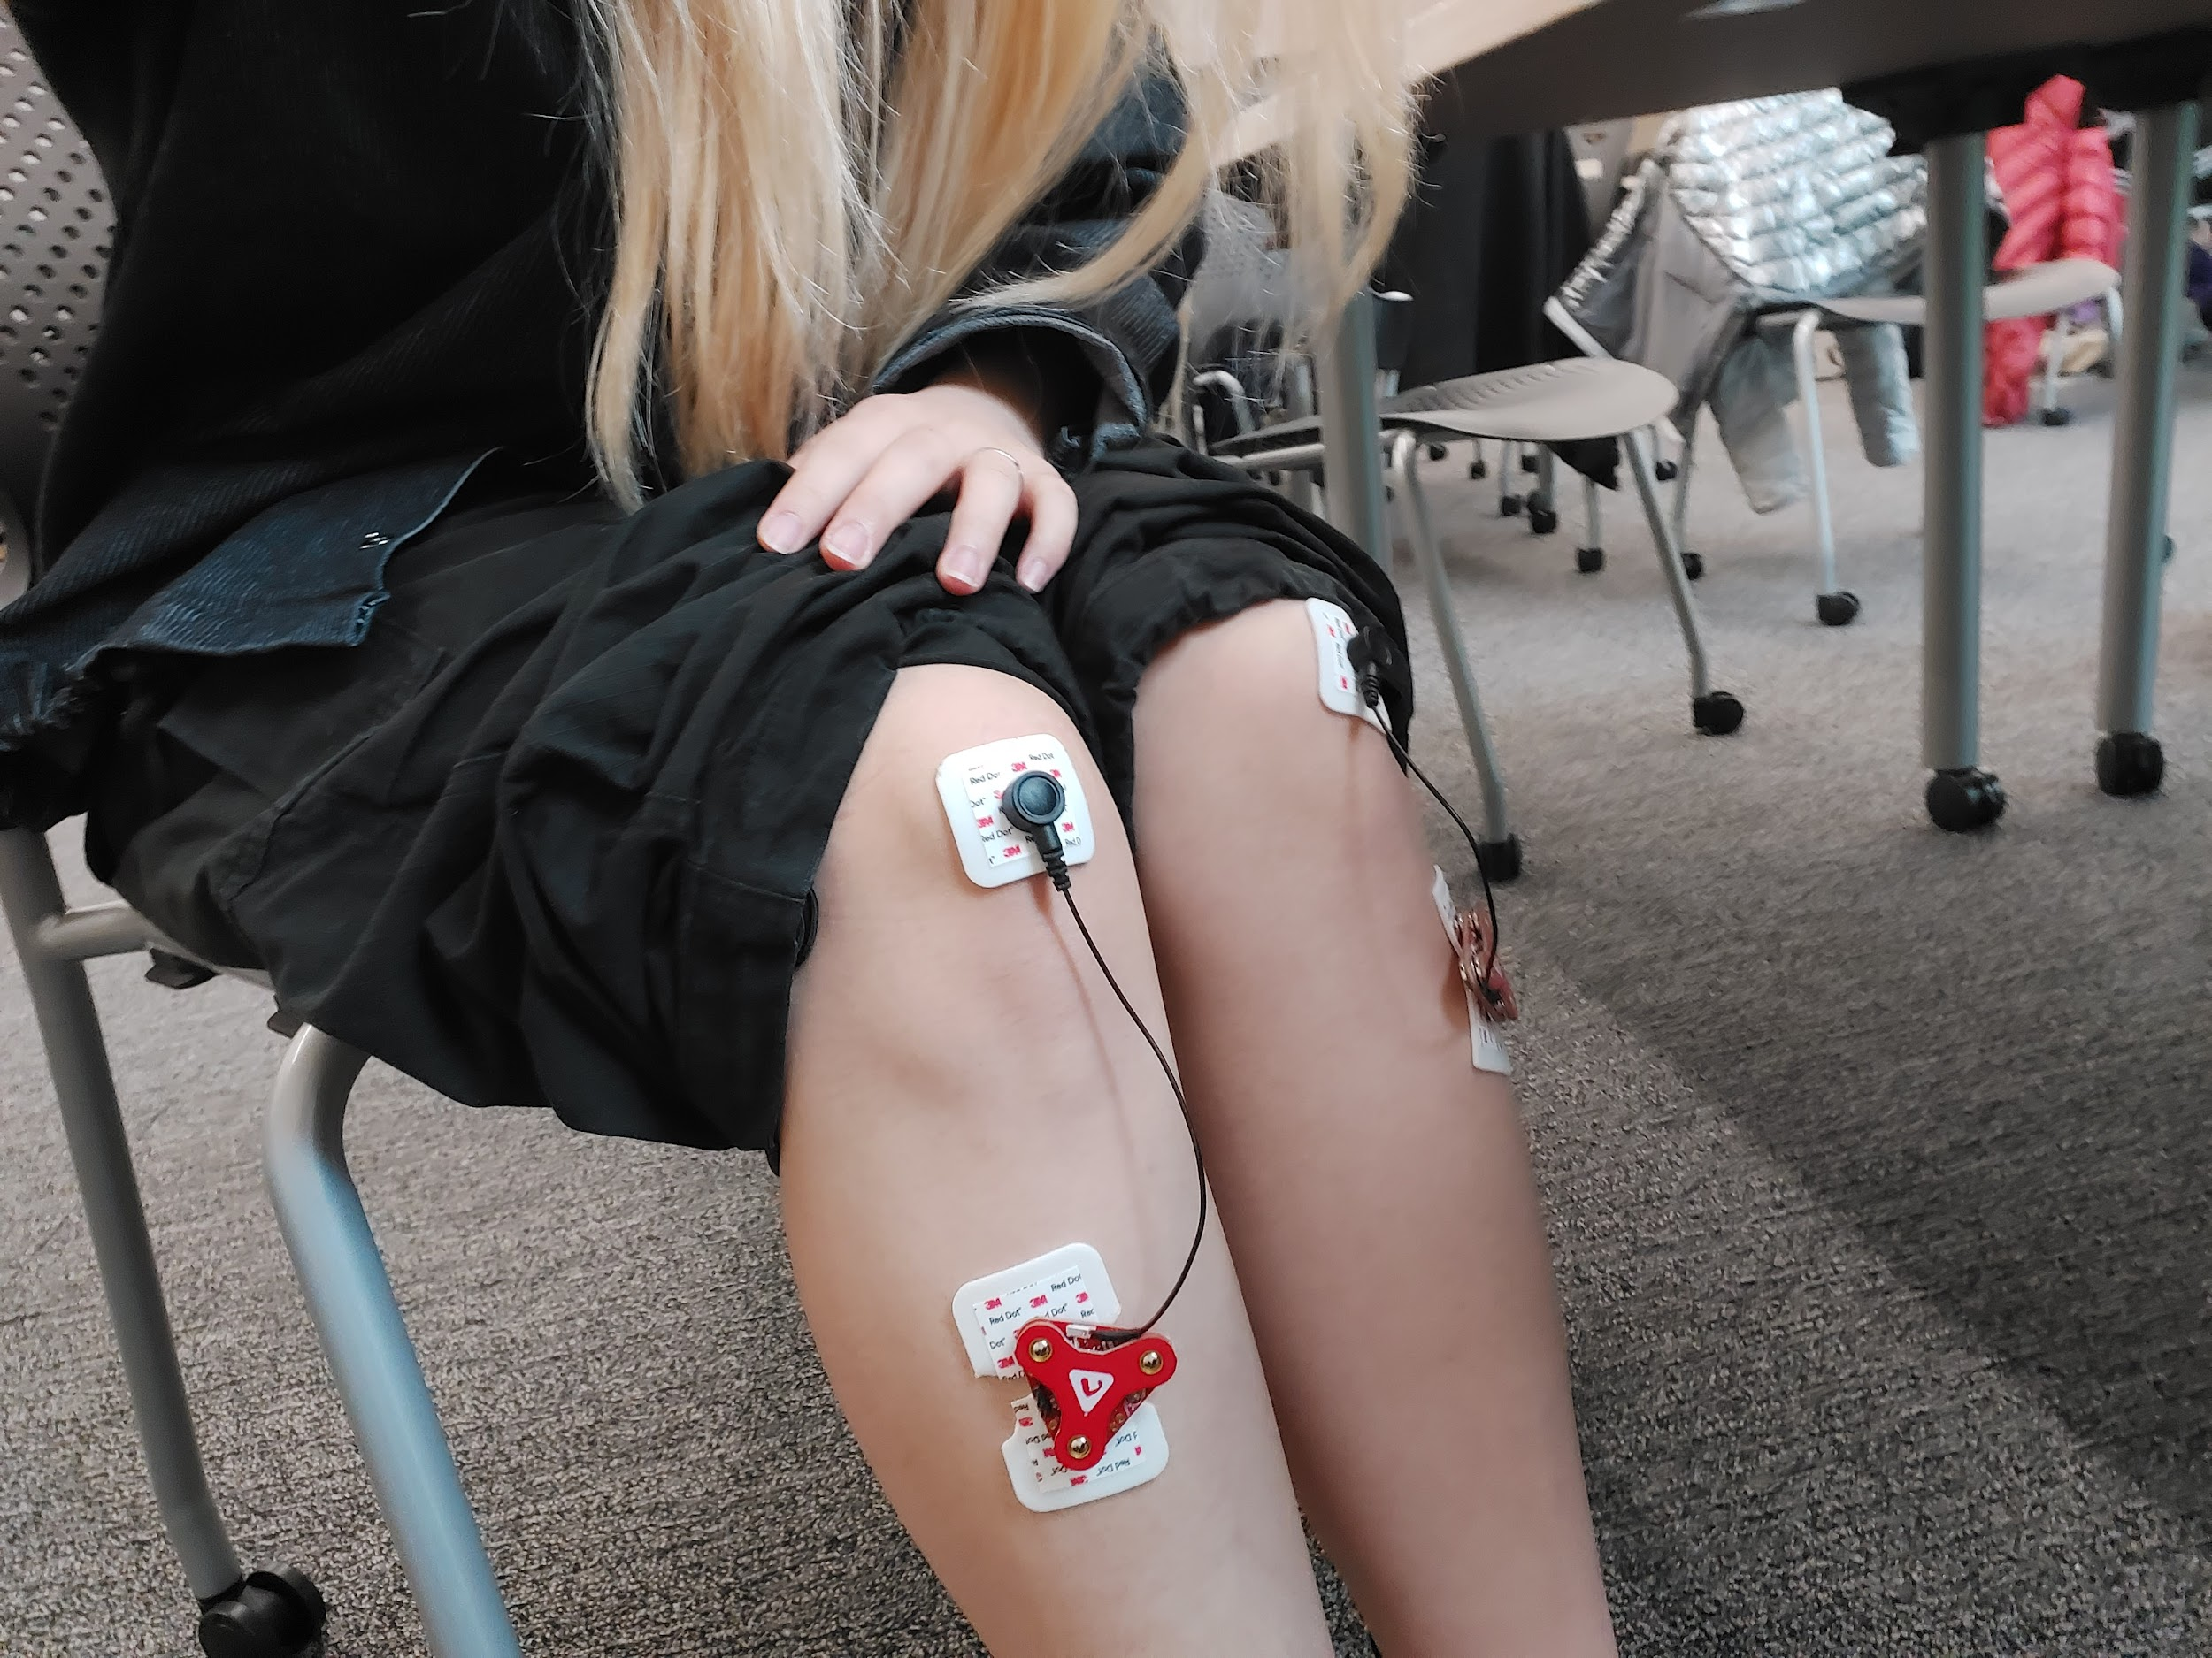
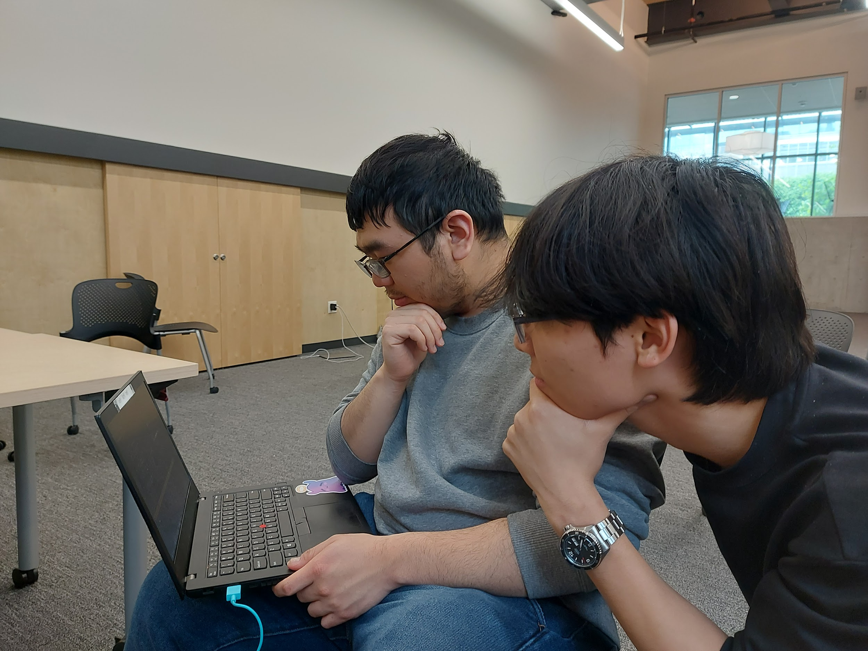
HOW IT WORKS
1. EMG Sensors: These sensors detect the electrical signals generated when muscles contract or relax.
2. The signals are sent to the ESP32 microcontroller, which processes them and determines what action to take based on whether the muscle is contracted or relaxed.
Program Built by Denise, James, and Brice

Slide 9
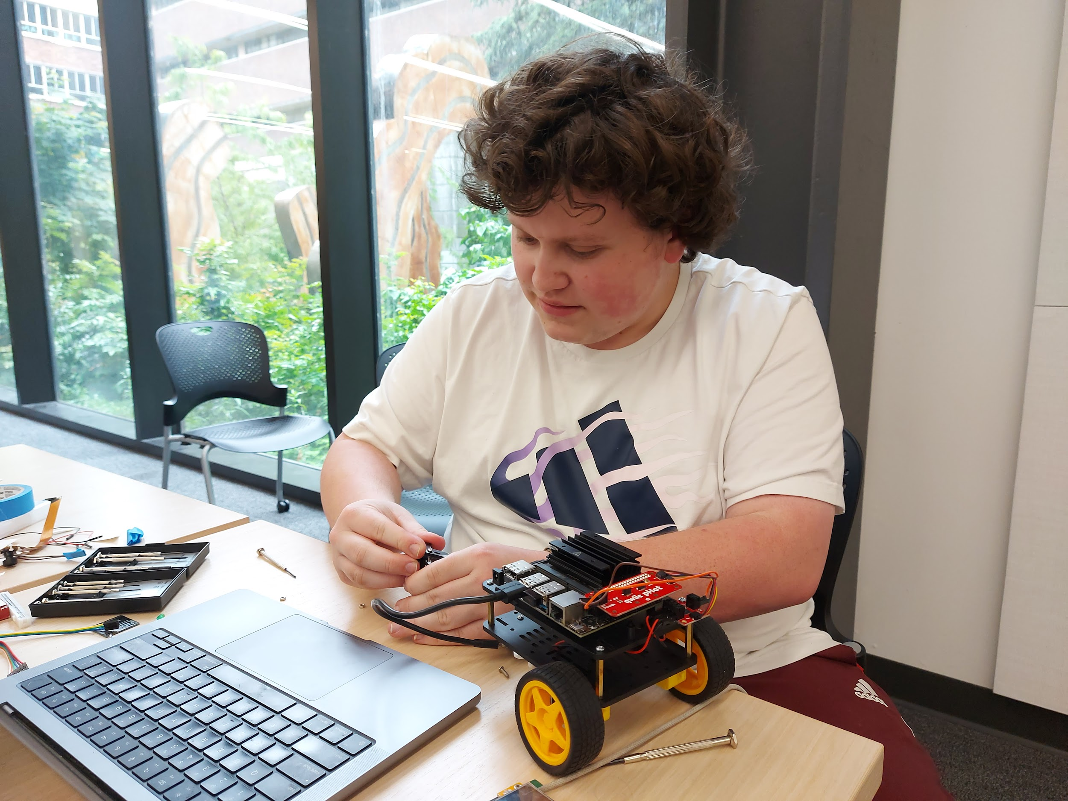

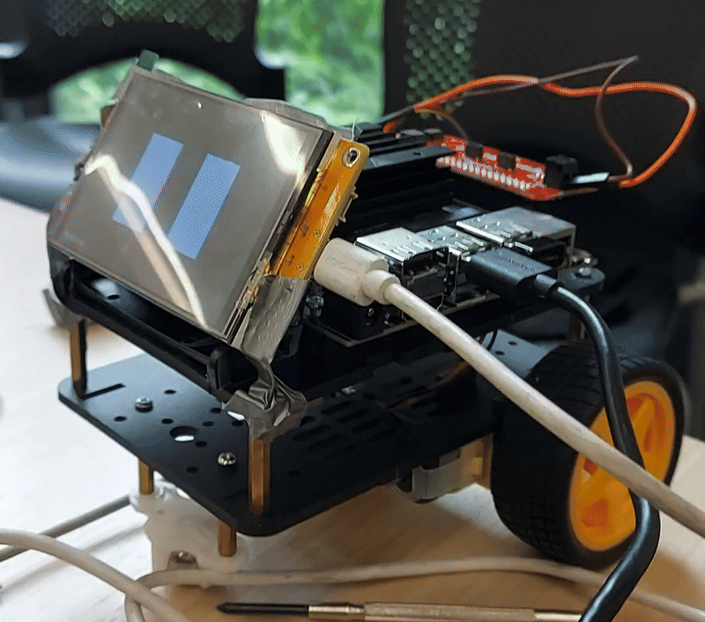
HOW IT WORKS
This biofeedback loop allows the child to control the car’s movement with their leg muscles, promoting motor control and rehabilitation in a playful, interactive way.
Robot Car Built By James

Slide 10

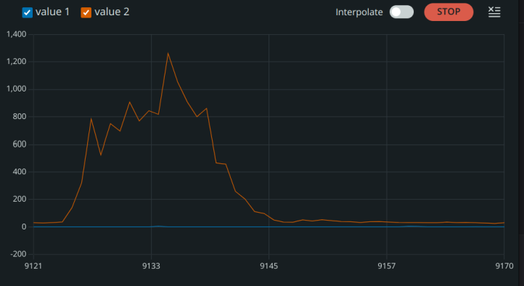
HOW IT WORKS
Example of Muscle Contraction
Path examples, increasing complexity

Slide 11


EXTENSIONS:
Can be used for any muscle group (for rehabilitation, multipurpose)
It’s a muscle controlled car, who doesn't want that?
Teaches children anatomy (focus on specific muscles)
It’s an inexpensive and fun product, I bet you want one right now:D

Slide 12

04
SOCIAL IMPACT AND ETHICS

Slide 13

SOCIAL IMPACT AND ETHICAL CONSIDERATIONS
Technical and Commercial Gaps
The goal is to create a low-cost, accessible, and intuitive muscle-controlled device that enhances rehabilitation efforts
There is a clear gap in the market for affordable, muscle-controlled devices that can aid in rehabilitation or assist individuals with disabilities
I.E. currently there aren’t any on the market

Slide 14

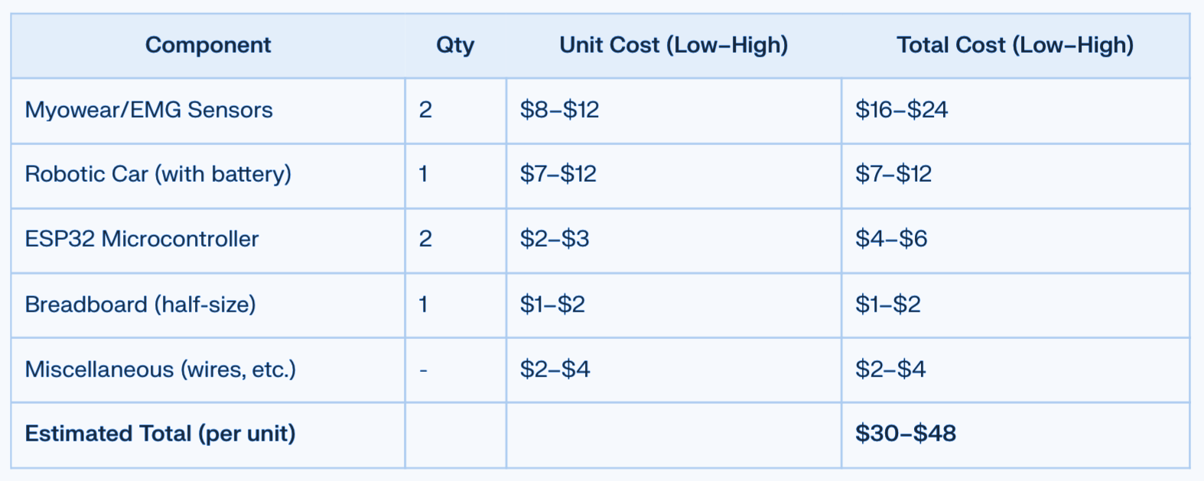
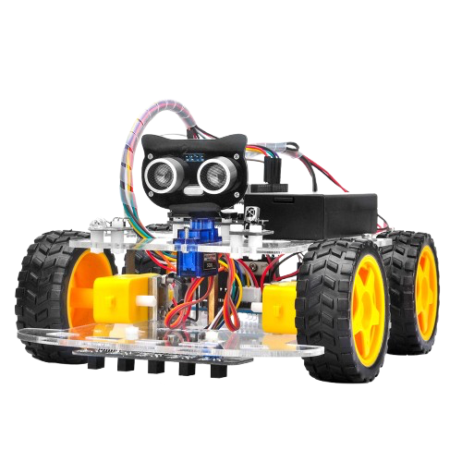
COST BREAKDOWN
Bulk Manufacturing Estimates
Source: Perplexity.ai

Slide 15


SOCIAL IMPACT AND ETHICAL CONSIDERATIONS
Ethics
Informed Consent and Understanding: For parents or guardians, it’s crucial that they fully understand how the system works
Environmental Safety: Since the car will move autonomously based on muscle signals, there’s the risk of the car bumping into objects or people, potentially causing injury

Slide 16
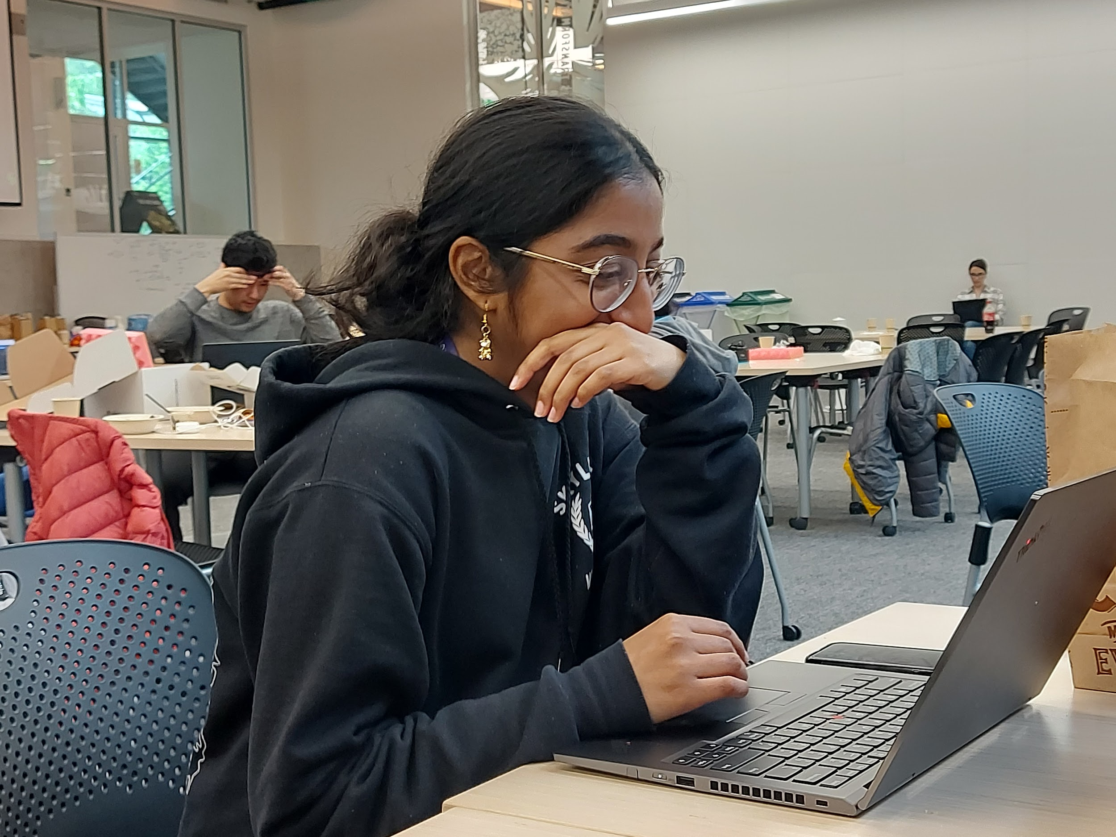
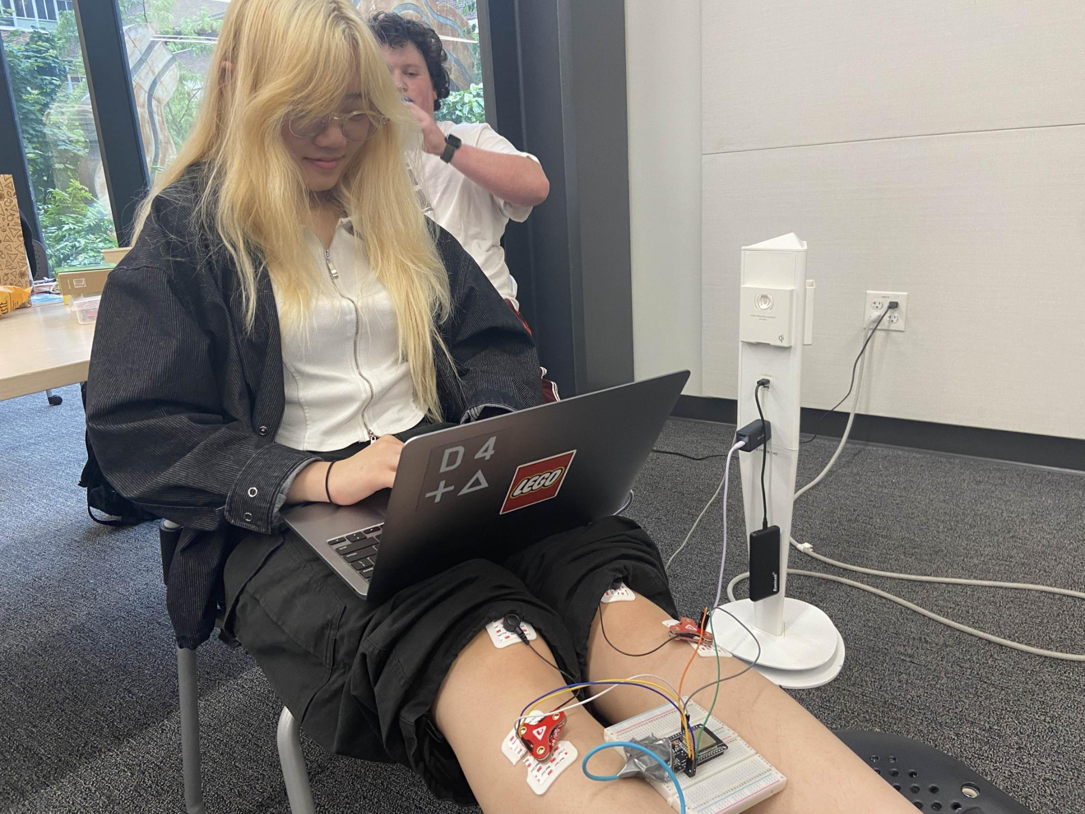
Slides Made By Navya & Lucy
THANK YOU!

Slide 17
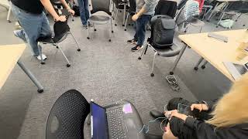

Slide 18
